Slide 1

Exploratory Data Analysis (EDA) of AMCET Dataset
Uncovering Patterns and Insights in the AMCET Data

Slide 2
About Me:
e
01
Kumar Raju N
B Com(Gen)
Why you want to learn Data Science
I want to be a detective but instead of that I choose Data Science because, Data science is like being a detective for information. You can gather clues (data) and solve mysteries (problems) by analyzing them closely.

Slide 3
Objective:
The goal of this EDA is to explore the AMCET dataset, understand data characteristics, uncover patterns, and prepare the data for further analysis
Dataset Overview:
Total records: 3998 rows in the dataset
Number of features: 39 features including personal, academic, skill and job –related information

Slide 4
Data Cleaning and Preprocessing & Data Summary and Initial Insights
Data Cleaning Steps:
Replaces “present” in the “DOL” column with “3/10/24 0.00”
Split dates in “DOJ”, “DOL” and “DOB” to keep only the date part
Converted “DOJ”, “DOL” and “DOB” to datetime format for easier analysis.
Dropped Columns:
Dropped “Unnamed: 0”, “ID”, “CollegeID” and “CollegeCityID” as they were not useful for analysis.
Feature Engineering:
Calculated the “Experience” in years as the difference between “DOL” and “DOJ”.
Handling Missing Values:
Checked for missing values (NA)
Checking for Duplicates:
No Duplicate Found
Numerical Summary:
Conducted basic stats on numerical features
Categorical Data Overview:
Distribution and count of different categories

Slide 5
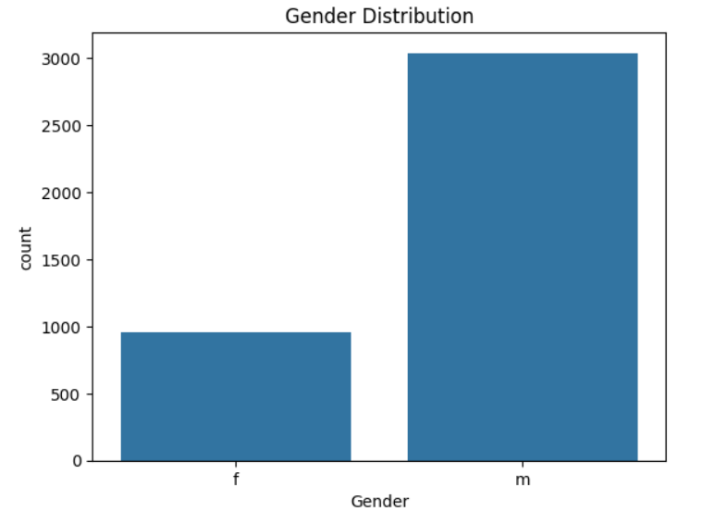
Gender Distribution
This plot shows the representation of each gender in the dataset.
It helps us to understand the proportion of male and female employees within the company
If one gender category significantly outnumbers the other, it indicates a potential gender imbalance in the dataset.
This could be due to various factors, such as historical hiring practices or Industry specific trends.

Slide 6
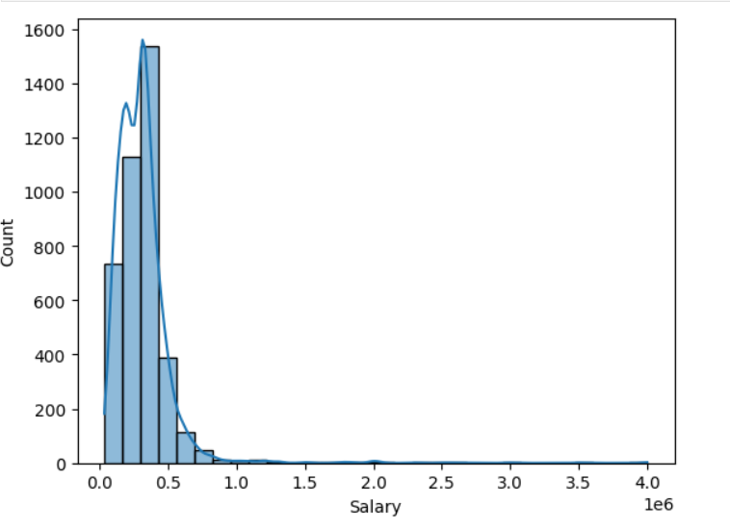
Distribution of Salaries
The salary distribution appears to be right-skewed (positively skewed).
This means that there are a larger number of employees with lower salaries and a smaller number with very high salaries.
The right-skewness suggests the possibility of outliers, which are employees with exceptionally high salaries, causing the tail of the distribution to extend further to the right.
It's likely that the company has a structure where a large number of employees receive similar, relatively lower salaries, with a smaller number receiving much higher salaries, possibly in leadership or specialized roles

Slide 7
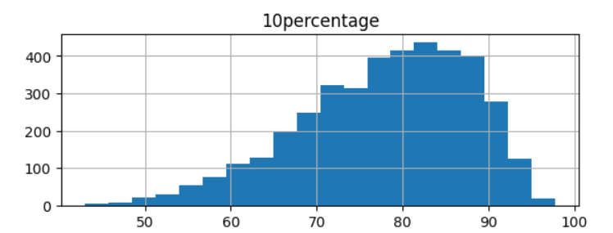
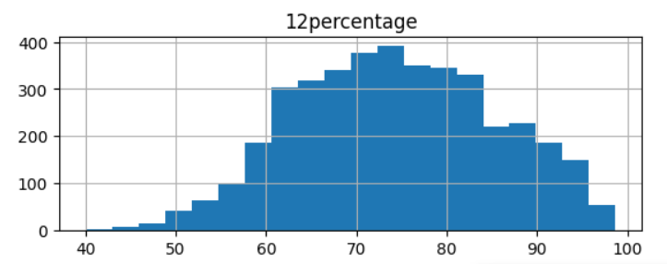
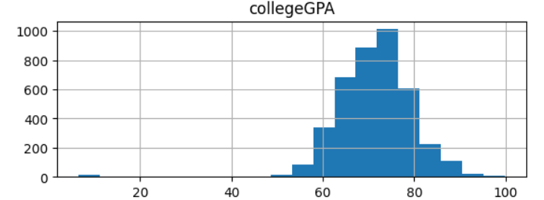
Distribution of academic scores
The distribution of 10th percentage scores appears to be roughly normal, with a peak around the middle range and a relatively symmetric spread.
The distribution of 12th percentage scores also appears to be relatively normal, with a peak around the middle range and a fairly symmetrical spread.
Similar to the 10th scores, this indicates that most employees have similar performance levels in their 10th and 12th standard education.
The distribution of college GPAs shows a slight right-skewness.
There might be a few individuals with significantly higher GPAs compared to the majority.

Slide 8
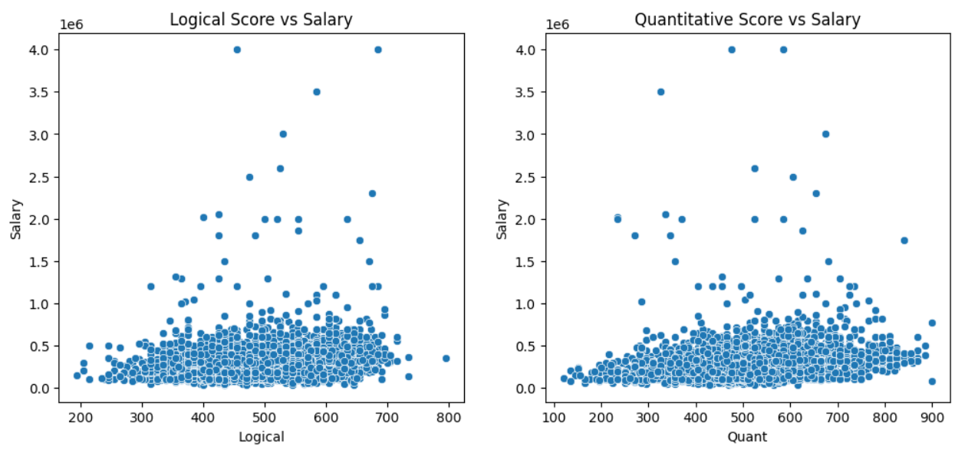
Logical and Quantitative scores affect salary
If scores increase along with salary, it indicates a positive relationship.
Closer points suggest a stronger correlation, while scattered points show a weaker one.
Look for points far from the trend; they might represent exceptions.
Groups of points could indicate other factors like experience or job role influencing salaries.
Higher logical and quantitative skills might lead to better-paying jobs if a positive trend is observed.

Slide 9
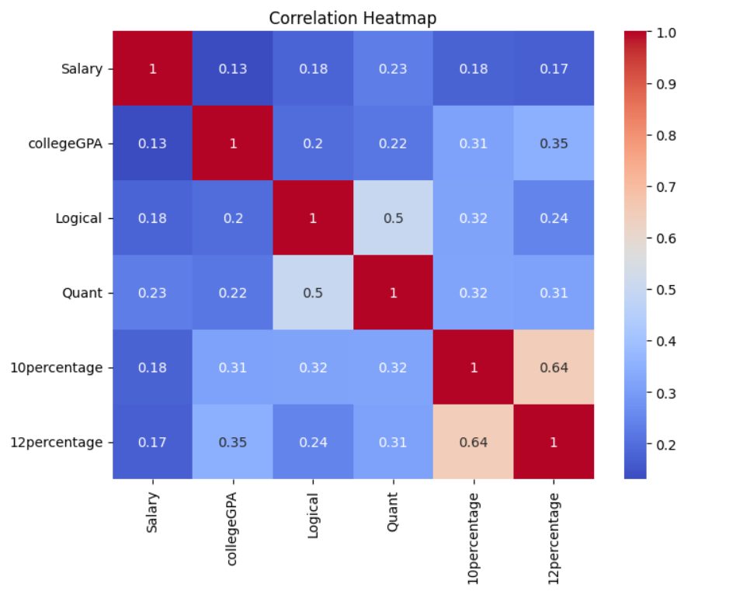
Correlation Heatmap
Values close to +1 indicate that as one variable increases, the other also tends to increase (e.g., Salary and collegeGPA).
Values close to -1 suggest that as one variable increases, the other tends to decrease.
Values near 0 imply little to no linear relationship between the variables.
Analyze the correlations between Salary and other variables (like collegeGPA, Logical, Quant).
A positive correlation implies that higher skill levels often lead to higher salaries (e.g., higher GPAs = higher salaries).
Look at correlations among skills (e.g., Logical and Quant). A strong correlation suggests individuals excel in both areas, indicating interconnected skills.

Slide 10
Conclusions :
Salary is influenced by a combination of factors, including specialization, educational background, skills, job location, and experience.
Strong analytical skills, high academic performance, and specialized expertise are consistently associated with higher earning potential.
Job location significantly impacts salary, with some cities offering substantially higher average salaries than others.
Experience plays a crucial role in salary progression, with individuals accumulating more experience often earning more.

Slide 11

THANK YOU

